Slide 1
Year 11 Careers

Slide 2
Outline of Qualifications
A range of qualifications are available to you upon completion of your GCSE exams
Different qualifications have different approaches to learning and will suit different people’s learning styles
3 Pathways available which can be described as Academic, Vocational/Technical & Work Related

Slide 3
Post 16 Options
Academic – A-Levels – 3 subjects – min. 5GCSE’s at Grade 5 +
Vocational – T-Levels – 1 subject area – Min. 5 GCSE’s grade 5 + focus on job-specific skills and knowledge via work placement.
Vocational Courses BTEC’s/NBVQ/City & Guilds– available in a range of careers areas with varying GCSE requirements depending on the area of interest and level.
Training Providers – offer a range of vocational training in different sector areas – Springboard, BL Hairdressing LEAD Education, Zenith People, SETA, Tyne North Training.
Apprenticeships – Work Related – GCSE maths & English are key. Real job, work as an employee while gaining a wage and professional qualifications. Find an apprenticeship - GOV.UK (www.gov.uk)

Slide 4
College Open Events - Autumn Term
Should your son/daughter be considering an application to study at a local college theses are ideal opportunities to get a feel for a college campus and the range of more vocational courses they can offer. All applications are online via the individual college websites:
South Tyneside – Tuesday 3rd October; Tuesday 7th November; Tuesday 5th December 5.00 – 7.00 pm (www.stc.ac.uk)
Sunderland – Tuesday 10th October (Bede Campus); Thursday 12th October (City Campus); Tuesday 14th November (City Campus); Thursday 16th November (Bede Campus) al 4.30 – 6.30 pm (www.sunderlandcollege.ac.uk)
Newcastle – Wednesday 4th October; Wednesday 8th November; Wednesday 6th December - 4.45 – 7.00 pm (www.ncl-coll.ac.uk)
Houghall College, Durham – Saturday 30th September 9.30-11.30; Wednesday 25th October 5.00-7.00pm (www.edc.ac.uk)

Slide 5
Careers Fayre in School - Friday September 22nd
A range of colleges, training providers, employers will be in school to offer your child valuable Career related Information and Advice to help your child make an Informed Decision on Post 16 pathways and future career paths:
Colleges – South Tyneside, Sunderland, Gateshead, Newcastle, East Durham & Houghall
Training Providers/Apprenticeship Providers – Springboard, Zenith People, LEAD Education (dance & outdoor education courses), SETA Engineering, Foundation of Light (sport & football scholarships), BL Hairdressing, Military Preparation Course, Gateshead Skills (Apprenticeship opportunities), NERAP (local universities information, Sunderland, Durham, Newcastle, Northumbria & Teesside)
Employers – Nissan, Unipress (engineering), WorkCast (software development), Police, Army, RAF, NHS, Navy, Civil Service, Space Science, Paramedics & Allied Health Professionals, Nursing, Fire & Rescue Service, Construction & Engineering, Architecture, Hays Travel, Civil Engineering, Microbiologists, Biomedical scientists, Biotechnology and Climate Control, Tech and Cyber Security

Slide 6
What is Unifrog?
Unifrog believe that destinations - where students end up after school - is even more important than their academic performance. They partner with schools to support students to progress into the best opportunity for them.
Unifrog do this by providing a one-stop-shop where students can explore their interests, then find and successfully apply for their best next-step after school.

Slide 7
The Unifrog tools
Recording what you’ve done
Searching for opportunities
Drafting application materials
Making applications
Quizzes
Exploring pathways
Interests profile
Careers library
Activities
UK universities
UK Personal Statement
Post 18 Intentions
Personality profile
Subjects library
Skills
US universities
Classes
Locker
Work environments profile
Know-how library
Interactions
European universities
Subject References
Applications list
MOOC
Oxbridge
CV / Resumé
Skills profile
Webinars
Canadian universities
Writing tool
Read, Watch, Listen
Asian universities
Common App Essay
Australasian universities
US recommenders
MidEast and Africa unis
Notes for Reference writers
Irish universities
Special Opportunities
Events

Slide 8
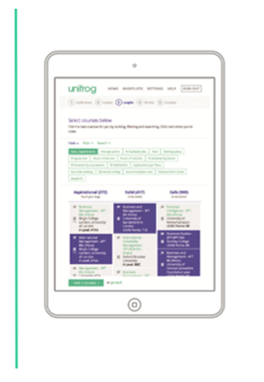
Quizzes
The tools in the Quizzes section allow students to understand how their personality, skills, and aptitudes relate to possible future pathways in a fun and engaging way.
Interests profile
Personality profile
Work environments profile
Skills profile

Slide 9
Exploring pathways
The tools in the Exploring pathways section allow your child to research the types of exciting options available to them after school.
Careers library
Subjects library
Know-how library
MOOC
Webinars
Read, Watch, Listen

Slide 10
Searching for opportunities
UK universities
US universities
The tools in the Searching for opportunities section allow you to compare universities, degree options and special opportunities around the world.
European universities
Oxbridge
Canadian universities
Asian universities
Australasian universities
MidEast and Africa unis
Irish universities
Special Opportunities
Events

Slide 11
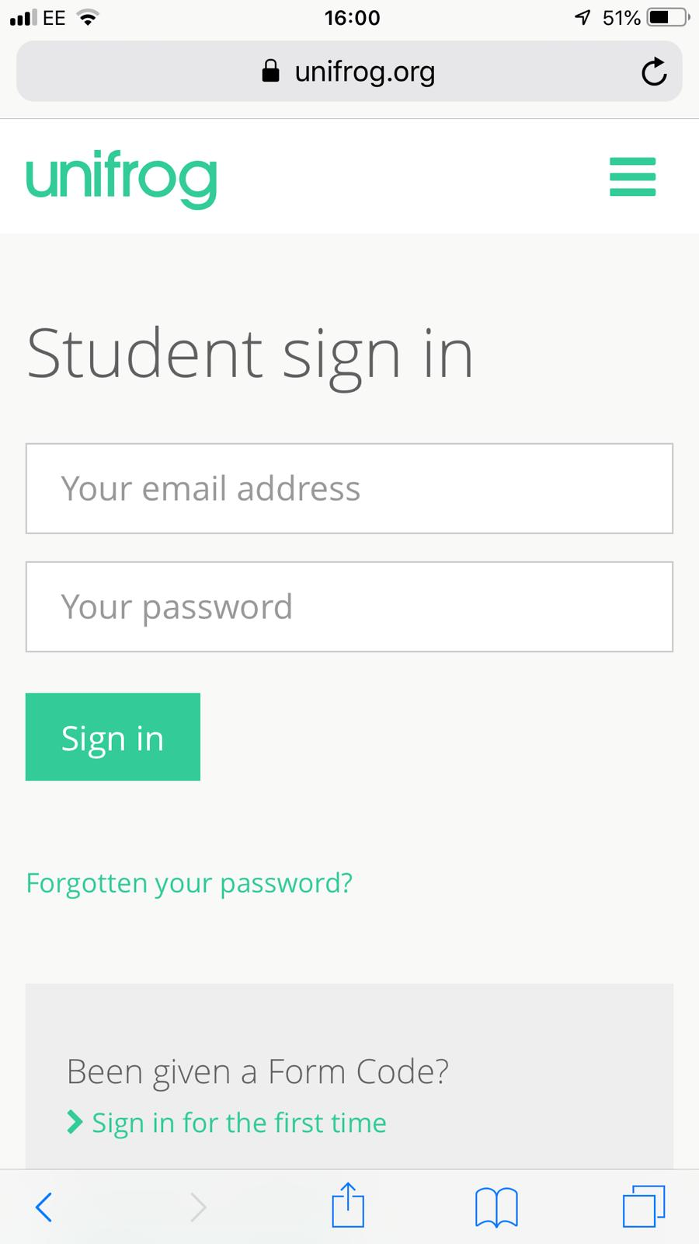
Parents & guardians, get signed up!
Scan this QR code or go to www.unifrog.org/student and click ‘Sign in for the first time’
You’ll be asked for some details and a Sign up Code. This is what you need:
WTBNParents
After signing up, log into Unifrog using your email address and password via the student sign-in page!
Notes:
Notes: Let help@unifrog.org know if you’d like to set up a parent code! Parent codes are only valid for 90 days so if your code is not visible on Unifrog at the link below, let us know on help@unifrog.org and we can create a new one for you:
https://www.unifrog.org/teacher/overview/sign-up-codes

