Slide 1
Overview of KS4 Courses and Recommended Revision Guides for Year 11
(Students sitting GCSE exams in May/June 2024)

Slide 2
English Language GCSE
Exam board | KS4 Course | Staff Contact | Recommended Revision Guides
AQA | GCSE English Language | Mrs Adamson | New GCSE English Language AQA Revision Guide - includes Online Edition and Videos - CGP Books

Slide 3
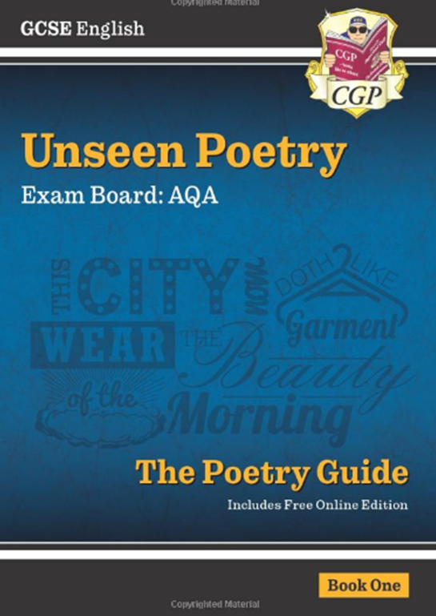
English Literature GCSE
Exam board | KS4 Course | Staff Contact | Recommended Revision Guides
AQA | GCSE English Literature | Mrs Adamson | New GCSE English text guide- An Inspector Calls CGP
 |  |  | New GCSE English text guide- A Christmas Carol CGP
 |  |  | New GCSE English AQA poetry Guide-Power & Conflict anthology CGP
 |  |  | New GCSE English AQA Unseen Poetry Guide-Book 1 CGP
 |  |  | GCSE English Shakespeare Text Guide - Macbeth includes Online Edition & Quizzes | CGP Books CGP

Slide 4
Maths GCSE - check if F or H level with your teacher
Exam board | KS4 Course | Staff Contact | Recommended Revision Guides
Pearson Edexcel | GCSE Mathematics | Mrs Bartch | GCSE Maths Edexcel Revision Guide Foundation - CGP | GCSE Maths Edexcel Revision Guide Higher - CGP

Slide 5
Science GCSE (Combined Science) - check if F or H level with your teacher
Exam board | KS4 Course | Staff Contact | Recommended Revision Guides
AQA | GCSE Combined Science: Trilogy | Mrs Pollard / Dr Holder / Miss Kiefer | GCSE Combined Science AQA Higher Complete Revision & practice - CGP | GCSE Combined Science AQA Revision Guide- Foundation - CGP

Slide 6
Separate Sciences – Biology, Chemistry and Physics - Higher
Exam board | KS4 Course | Staff Contact | Recommended Revision Guides
AQA | Biology | Mrs Pollard | GCSE Biology AQA Revision Guide-Higher - CGP
AQA | Chemistry | Dr Holder | GCSE Chemistry AQA Complete Revision & practice - CGP
AQA | Physics | Miss Kiefer | GCSE Physics AQA Complete Revision & Practice - CGP

Slide 7
Art and Design Technology Subjects – Art, Graphics, Food Tech
Exam board | KS4 Course | Staff Contact | Recommended Revision Guides
AQA | GCSE Art & Design (Fine Art) – Years 10 and 11 | Mrs Dembry | None
AQA | GCSE Art & Design (Graphic Communication) – Year 10 | Mrs Craig | None
WJEC EDUQAS | GCSE in Food Preparation and Nutrition – Year 10 | Mr Hendry | Eduqas GCSE Food preparation and Nutrition: Revision Guide

Slide 8
Humanities Subjects – Geography, History and RE
Exam board | KS4 Course | Staff Contact | Recommended Revision Guides
AQA | GCSE Geography | Mrs Matterson | GCSE 9-1 Geography AQA Revision Guide - Oxford
AQA | GCSE History | Mrs Jordan | Oxford AQA GCSE History (9-1): America 1920-1973: Opportunity and Inequality
 |  |  | Oxford AQA GCSE History: Elizabethan England c1568-1603
 |  |  | Oxford AQA GCSE History (9-1): Britain: Power and the People c1170-Present Day
 |  |  | Oxford AQA GCSE History: Conflict and Tension: The Inter-War Years 1918-39
AQA | GCSE Religious Studies A | Dr Henderson | AQA GCSE Religious Studies A: Christianity and Islam Revision Guide: With all you need to know for your 2022 assessments (GCSE Religious Studies for AQA)

Slide 9
Option Subjects – Business, Computing and ICT
Exam board | KS4 Course | Staff Contact | Recommended Revision Guides
Pearson | GCSE Business | Ms Thirlwell | Pearson REVISE Edexcel GCSE (9-1) Business Revision Guide: For 2024 and 2025
AQA | GCSE Computer Science | Mr Mulford | GCSE Computer Science AQA Complete Revision & practice
OCR | OCR Level 1/Level 2 Cambridge National in IT | Mr Mulford | None

Slide 10
Option Subjects – PE and Sport Studies
Exam board | KS4 Course | Staff Contact | Recommended Revision Guides
AQA | GCSE Physical Education | Mr Leggett | AQA GCSE (9-1) PE Second Edition
OCR | OCR L1/2 Cambridge National Certificate in Sport Studies | Mr Mackey | Level 1/Level 2 Cambridge National in Sport Studies (J829): Second Edition –

Slide 11
Option Subjects – Sociology and Child Development
Exam board | KS4 Course | Staff Contact | Recommended Revision Guides
OCR | OCR Cambridge National in Child Development | Mrs Tennet | Cambridge National in Child Development Revision Guide and Workbook
AQA | GCSE Sociology | Miss Boswell | AQA GCSE 9-1 Sociology Workbook: Ideal for home learning, 2022 and 2023 exams

Slide 12
Option Subjects – MFL - French and Mandarin
Exam board | KS4 Course | Staff Contact | Recommended Revision Guides
AQA | GCSE French | Mrs Watson | Pearson Revise AQA GCSE French (9-1) French revision guide
 |  |  | Pearson Revise AQA GCSE French (9-1) French revision workbook
 |  |  | GCSE French AQA Exam Practice Workbook - for the Grade 9-1 Course
AQA | GCSE Chinese (Mandarin) | Mrs Kirk | Secondary School Chinese Workbook 1 (AQA)
 |  |  | GCSE Chinese practice workbook and papers

Slide 13
Option Subjects – Media Studies and BTEC Creative Media
Exam board | KS4 Course | Staff Contact | Recommended Revision Guides
WJEC - Eduqas | GCSE Media Studies | Mr Thompson | WJEC/Eduqas GCSE Media Studies Revision Guide
Pearson Edexcel | BTEC L1/2 Tech Award in Creative Media Production | Mr Thompson | None

